Slide 1


Medical Center Management System

Slide 2
OUR TEAM
Group Number : WE_B01_01_W204
Registration Number | Name | Function
IT23588714 | K.H.S Dinsara | User Management
IT23543232 | Navodya A.K. | Supplier Management
IT23572638 | Thathsarani J R | Laboratory management
IT23810464 | Ekanayaka E.W.I.D | Bill & Payment Management
IT23669758 | Liyanaarachchi L.A.D.A | Inventory Management
2

Slide 3
Introduction
This system helps medical centers manage appointments, patients, staff, and medical inventory in one place. It replaces manual processes with a digital platform, making healthcare services faster and more organized. Patients can book appointments, medical staff can track consultations and treatments, and administrators can monitor operations easily. It improves efficiency, accuracy, and patient satisfaction
2

Slide 4

PROBLEMS
No Real-Time Updates for Patients
Manual Inventory Tracking
Inefficient Record Keeping & Poor Coordination
Low Patient Satisfaction
Lack of Centralized System

Slide 5

AIM & OBJECTIVES
AIM
OBJECTIVES
Allow patients to book appointments
Track medical inventory and supplies
Simplify billing and payment processing
Maintain secure digital patient records
Enhance patient satisfaction
The aim of this project is to build a system that helps medical centers operate more efficiently by managing appointments, patient records, staff, medical inventory, and billing all in one place
2

Slide 6



Literature REVIEW
Feature | Zocdoc | Our System
Appointment Booking
Inventory Handling
Staff Management
Medical Records Storage
Laboratory Management
Zocdoc is a popular online platform that helps patients find doctors, book appointments, and receive healthcare services easily. It allows users to search by specialty, location, insurance, and availability, offering a fast and convenient way to access in-person or virtual medical care across the U.S.
2

Slide 7


Methodology
We used the Agile development methodology to build the medical appointment system.
The project was divided into sprints, each focusing on a specific set of features.
Each sprint included planning, development, testing, and review stages.
Regular team meetings helped us track progress and resolve issues quickly.
We continuously improved the system based on user feedback and test results.
2

Slide 8
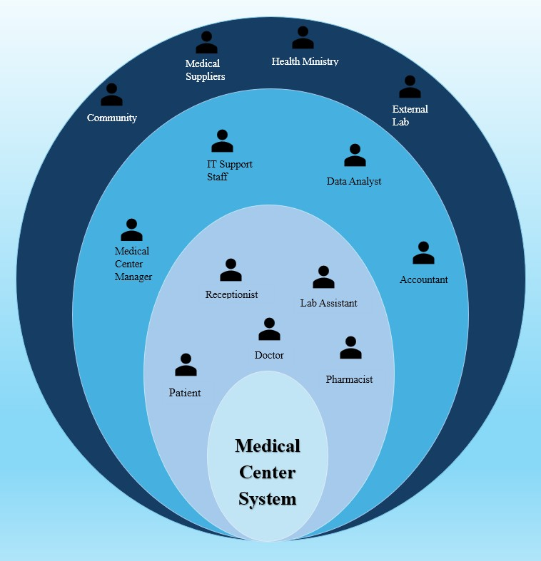
- Onion Diagram
Methodology
2

Slide 9
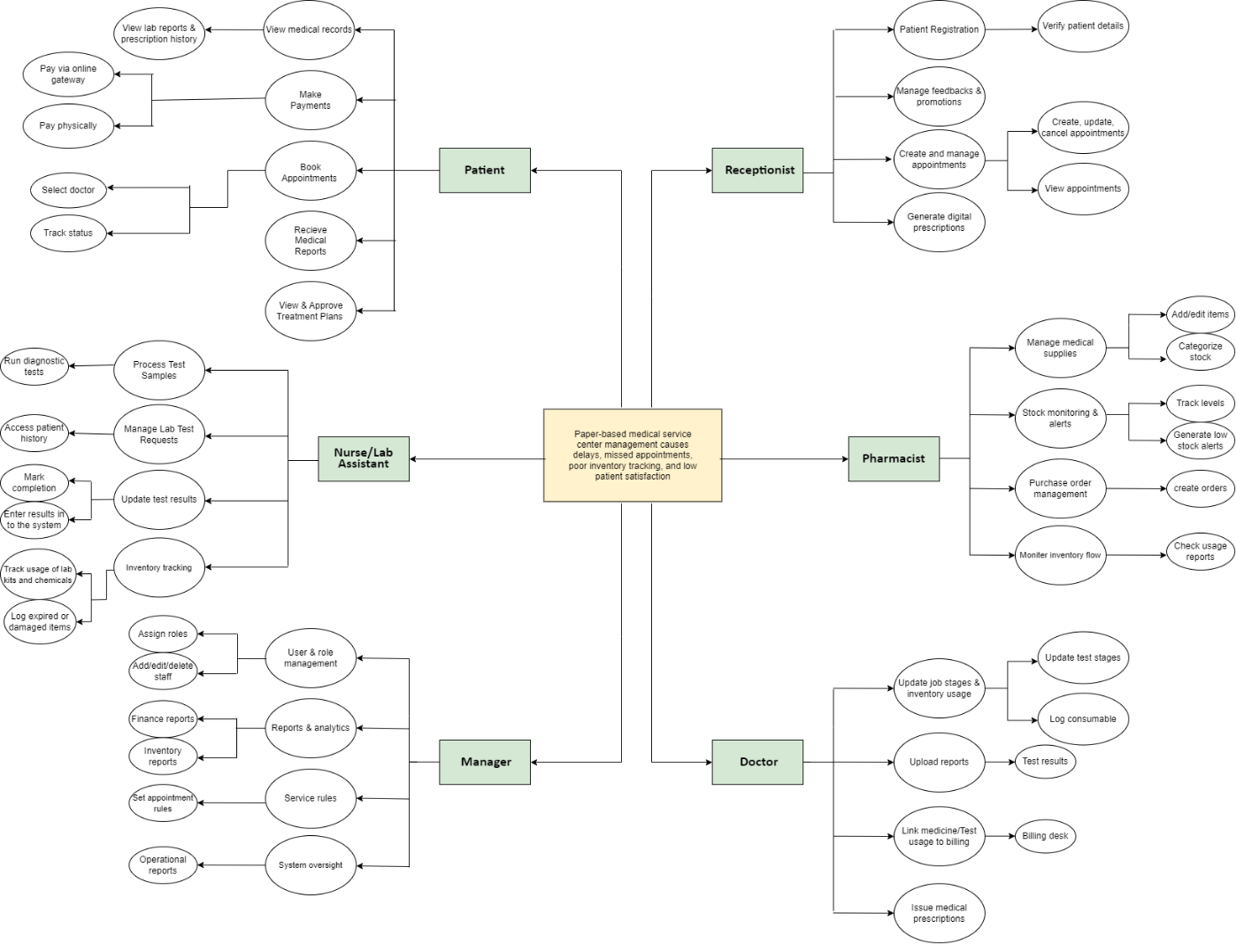
- Mind Map
Methodology
2

Slide 10

FUNCTIONAL REQUIREMENTS
User Management and Booking
Appointments
Laboratory Management
Inventory Management
Supplier Management
Bill & Payment Management
2

Slide 11

user Management & booking appointments
User Management and Appointment Booking modules are key features that help patients and staff interact with the system smoothly.
User registration and login
Role-based access control (Patient, Staff, Manager)
Secure password handling
(Encryption / Authentication)
Patients book appointments by selecting doctor,date, time, and type
Assigns an available doctor
Patients can view, edit, or cancel appointments
Manage their profile and track medical records
2

Slide 12
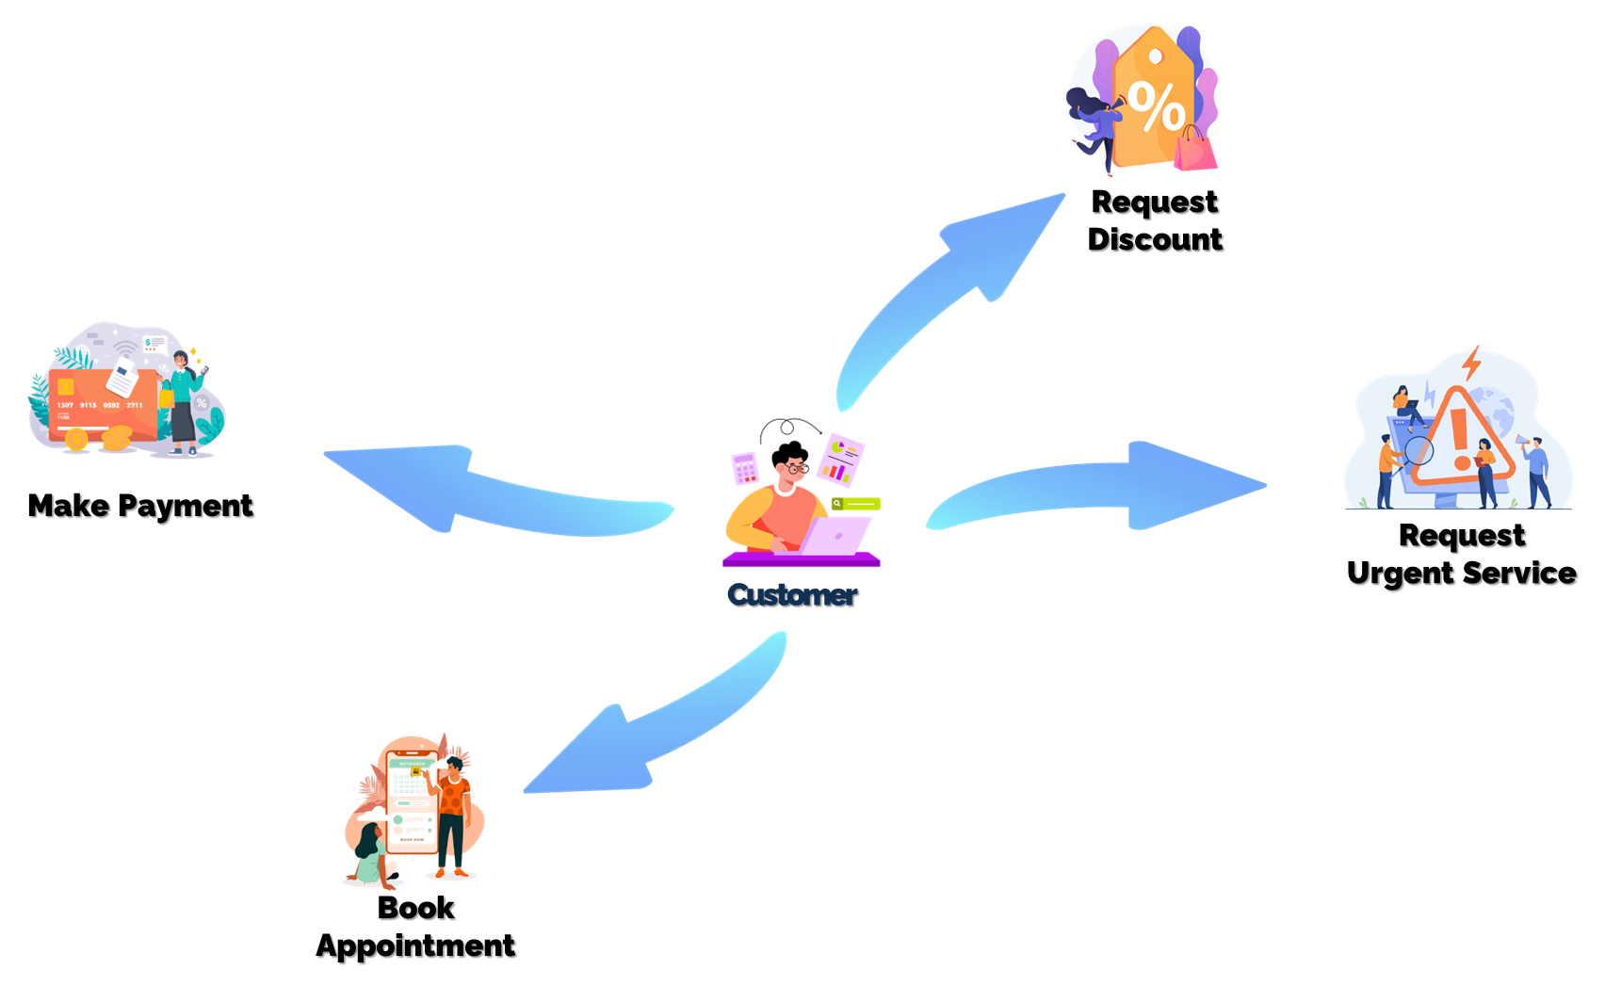
user Management and booking appointments
Patient
2

Slide 13
Laboratory management
Check the patient’s test request and identify required lab tests
Track the test’s progress from sample collection to result generation
Generate a test prescription for the patient
Keep the patient updated about test status and result availability
Collect and label patient samples accurately
Verify test results before approval
Laboratory Management and Test Booking lab modules are key features that help patients and lab staff interact with the system smoothly.
2

Slide 14
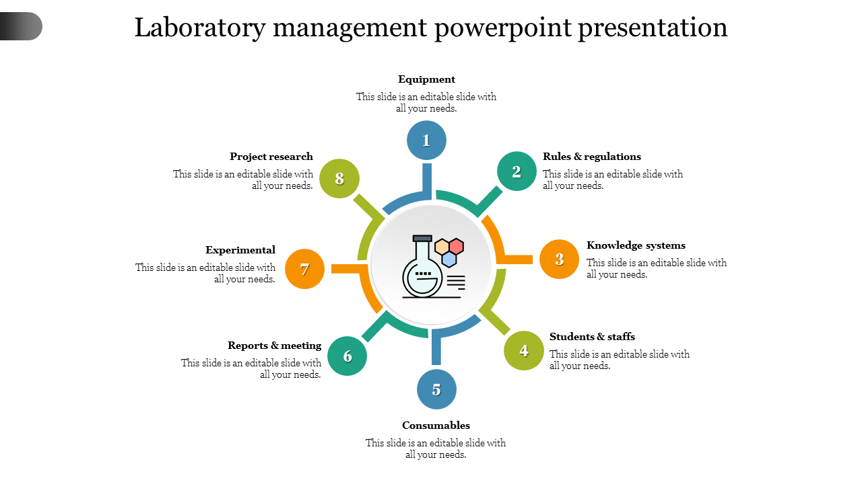
Laboratory management
Check the patient’s test request and identify required lab tests
Keep the patient updated about test status and result availability
Track the test’s progress from sample collection to result generation
Collect and label patient samples accurately
Generate a test cost slip or invoice for the patient
2

Slide 15
Inventory management
The Inventory Management module helps the medical center keep track of all medicines and medi-kits. It ensures that parts are always available when needed, avoids stock shortages, and allows smooth connection between patient and inventory.
Component operations for medicines
(Create, Read, Update, Delete)
Low-stock alert system based on reorder levels
Requesting orders from suppliers when stock is low
Supplier information Handling
Inventory usage logs and history tracking
2

Slide 16
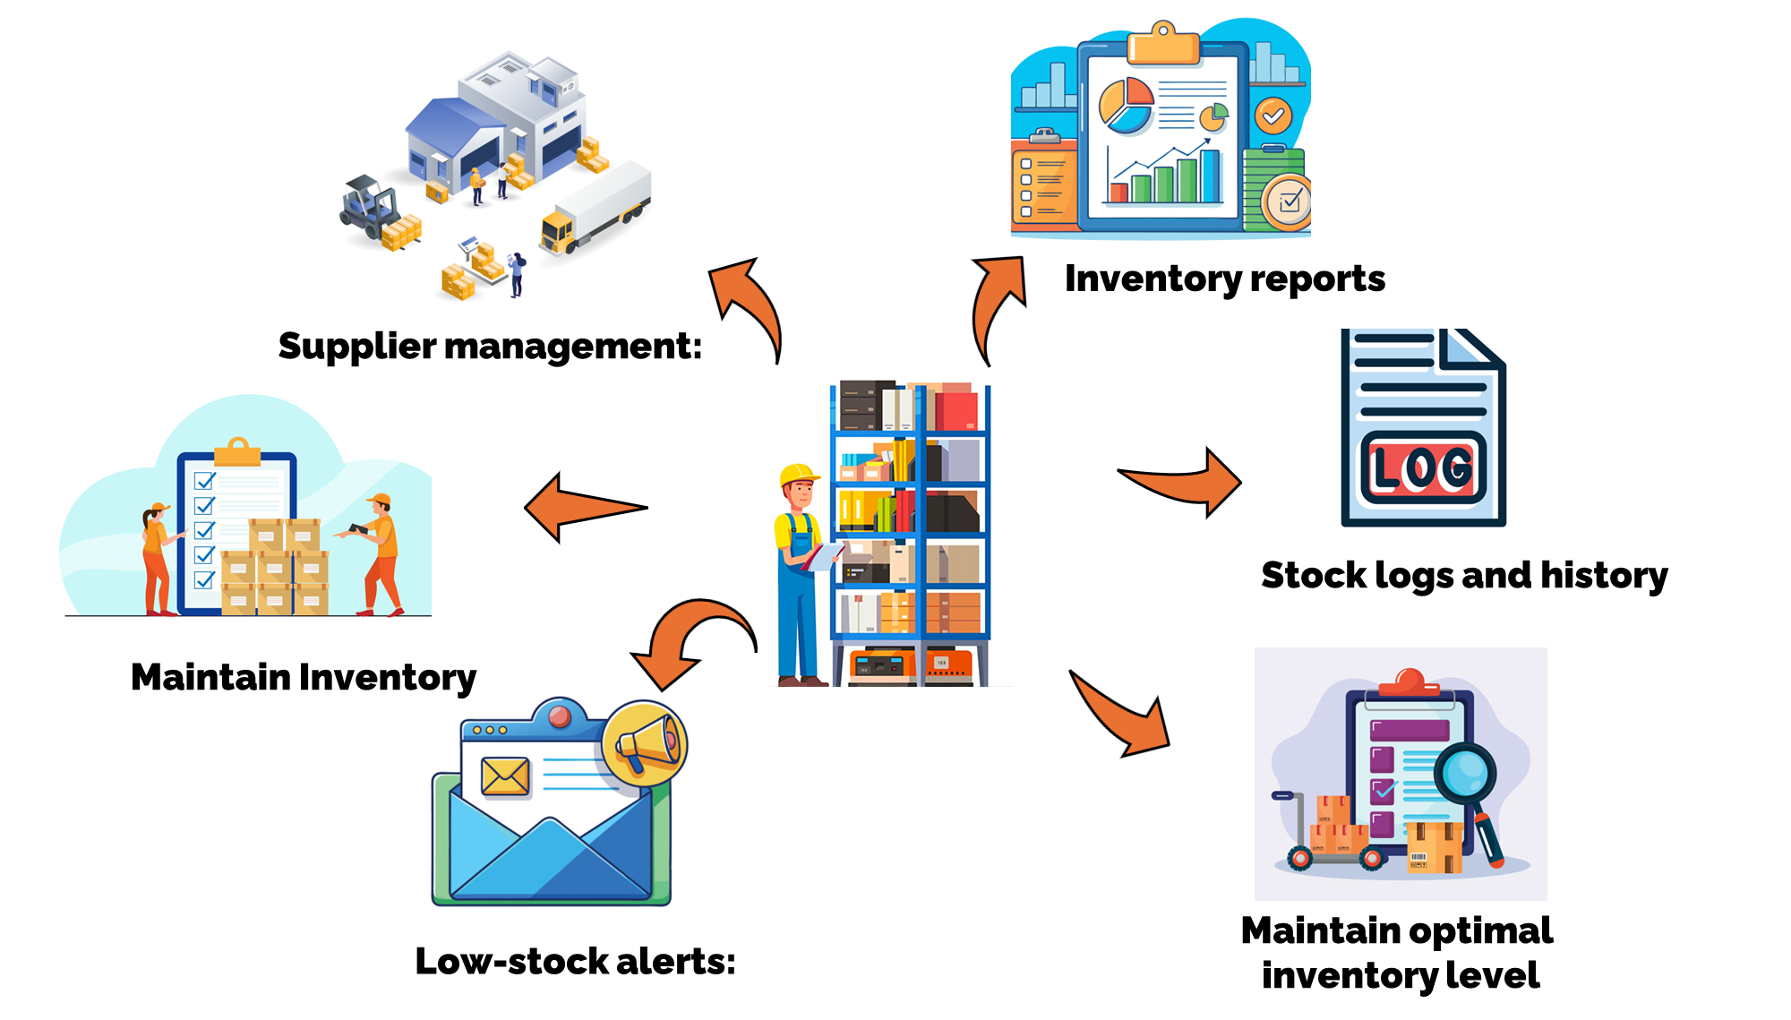
Inventory management
2

Slide 17
Supplier management
The Supplier Management module helps the medical center manage relationships with medicine and equipment suppliers. It ensures timely procurement of medical supplies, avoids stock shortages, and maintains a smooth supply chain between suppliers and the inventory system.
Purchase Order Generation
Delivery History Tracking
Managing account details
2

Slide 18
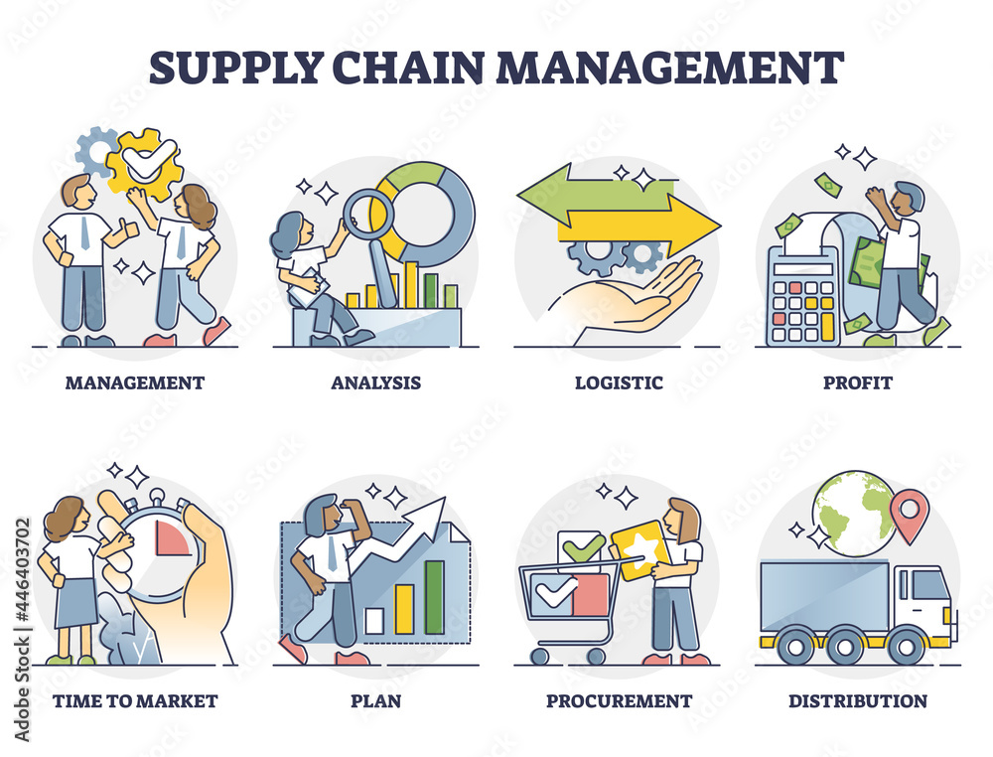
Supplier management
2

Slide 19
Bill & Payment management
Transaction recording and tracking.
(invoices, payments, receipts)
Budget management and expense monitoring.
Profit and loss analysis reports.
Integration with inventory for billing.
Supplier payment scheduling and tracking.
Tax calculation and compliance support.
Financial statement generation.
(income, balance sheet)
Export options for reports. (PDF, Excel)
The Bill & payment Management module helps the center track income, expenses, and financial performance. It ensures accurate budgeting, timely payments, and financial transparency, allowing better decision making and resource planning.
2

Slide 20
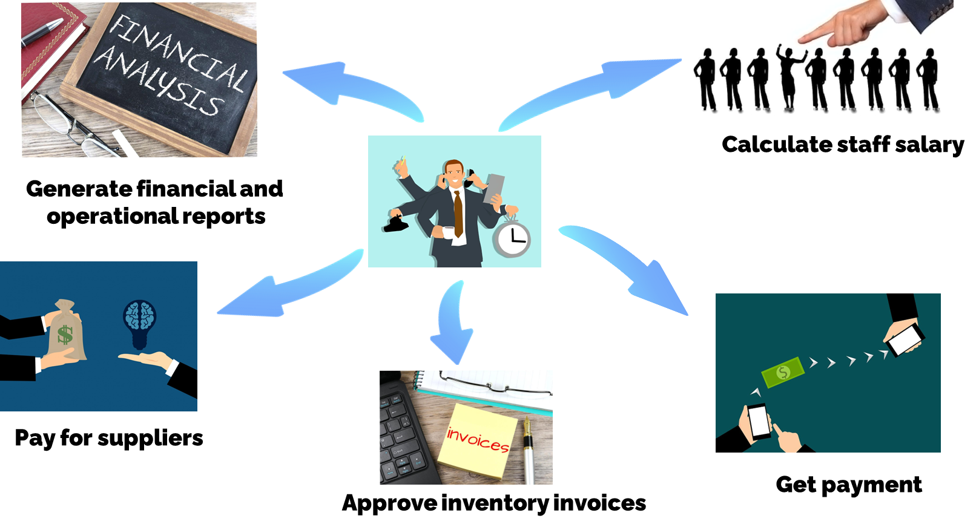
Bill & Payment management
2

Slide 21

Non-FUNCTIONAL REQUIREMENTS
Usability
Availability
Efficiency
Accuracy
Confidentiality
Security
Auditability
Privacy
2

Slide 22

technical REQUIREMENTS
Hardware
User Interface
Operating System
Database Management
2

Slide 23

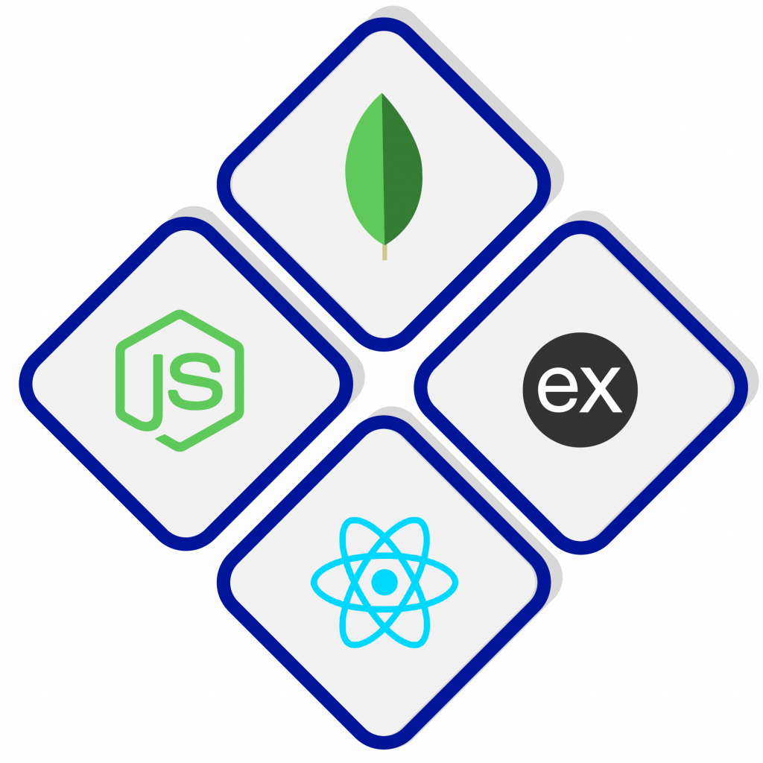
Tools & technology
React JS
VS Code
React.js developers design and implement user interface components for JavaScript-based web and mobile applications using the React open source library ecosystem.
Visual Studio Code is a source-code editor made by Microsoft for Windows, Linux and macOS. Features include support for debugging, syntax highlighting, intelligent code completion, snippets, code refactoring, and embedded Git.
Node JS
Node.js (Node) is an open-source development platform for executing JavaScript code server-side. Node is useful for developing applications that require a persistent connection from the browser to the server and is often used for real-time applications such as chat, news feeds and web push notifications.
MongoDB
MongoDB is a source-available cross-platform document-oriented database program. Classified as a NoSQL database program, MongoDB uses JSON-like documents with optional schemas
2

Slide 24

conclusion
The Medical Service Center system brings together all key roles to work smoothly. Staff handle daily services, the finance manager, manages money and payments, the inventory manager keeps track of parts and tools, and the receptionist guides patients on their doctor appointments and lab tests. Together, they ensure efficient service and patients satisfaction.
2

Slide 25


Thank
You
2

